Slide 1

Abalone Age Prediction
Hao Heng, Shuang ma, ziyu huang
Group # 4

Slide 2
Contents
Background
Dataset Description
Preprocessing
Models
Results
Summary and conclusion
Limitations and proposed solutions

Slide 3
Background

Slide 4
Background
Abalone is delicacy.
The economy value is closely correlated with the age.
Age of abalone is hard to determine.
Age = Rings + 1.5

Slide 5
Linear Regression Random Forest Logistic Regression Multiple Layer Perceptron

Slide 6
Dataset Description

Slide 7
Variable Introduction
Sex(Categorical): Male, Female, Infant
Length(Continuous) : Longest Shell Measurement
Diameter (Continuous) : Perpendicular to Length
Height (Continuous) : With meat in shell
Whole Weight (Continuous) : Whole abalone
Shucked Weight (Continuous) : Weight of meat
Viscera Weight (Continuous) : Gut weight after bleeding
Shell Weight (Continuous) : After being dried
Rings (Continuous) :+1.5 Gives the age in years

Slide 8
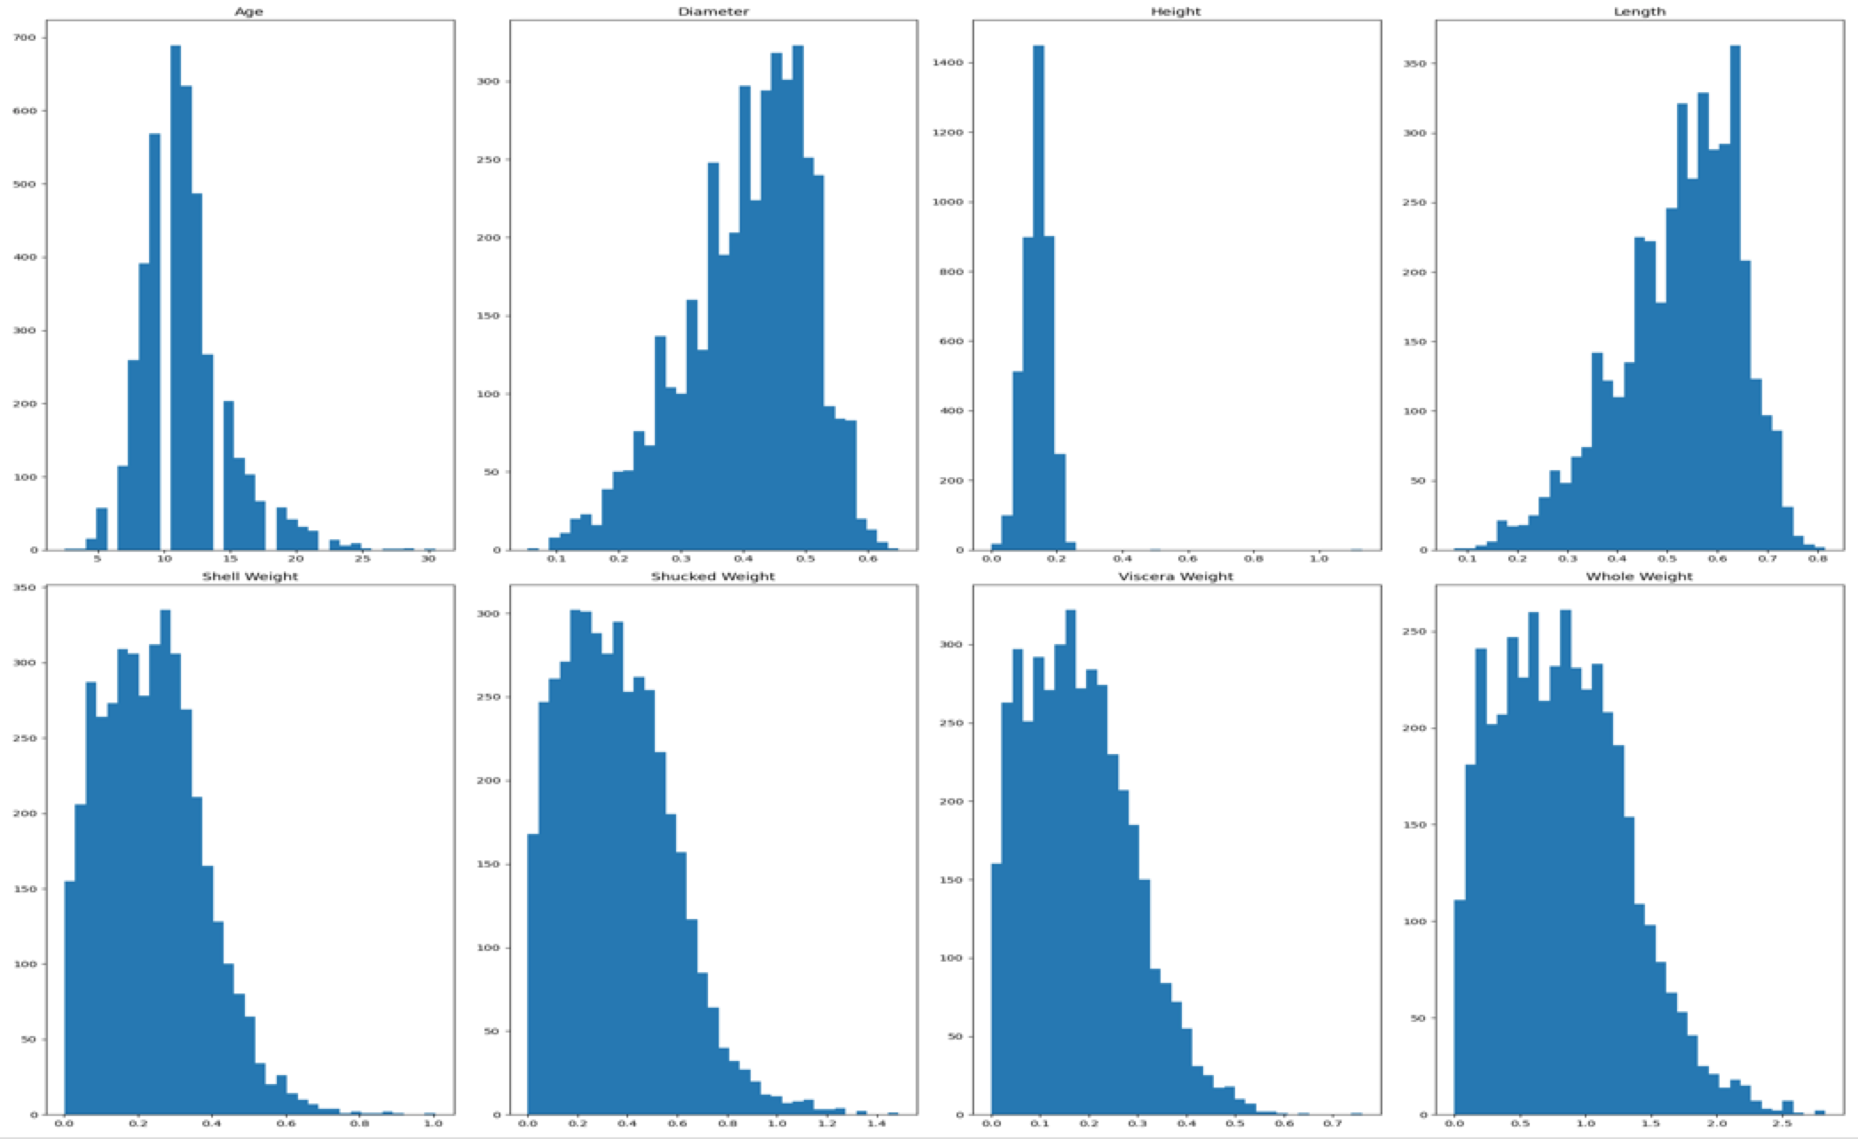
Data Distribution

Slide 9
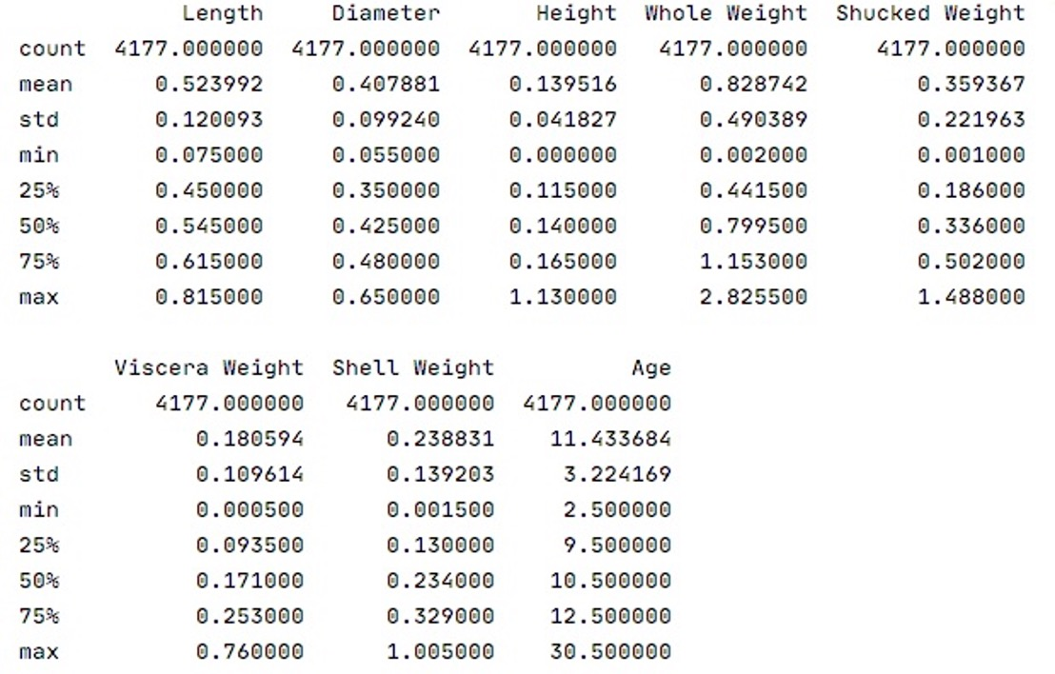

Slide 10
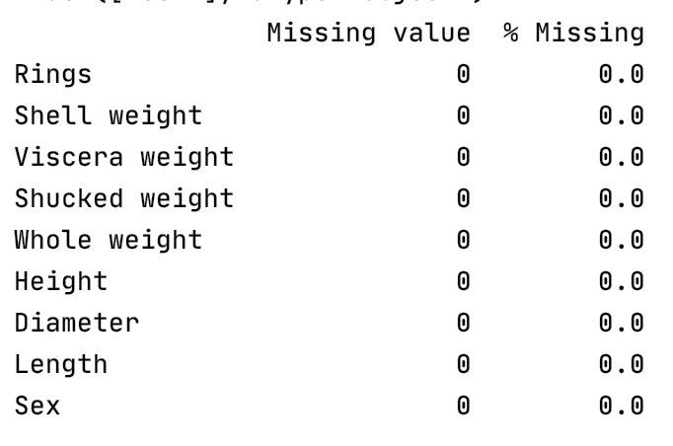
Check missing value

Slide 11
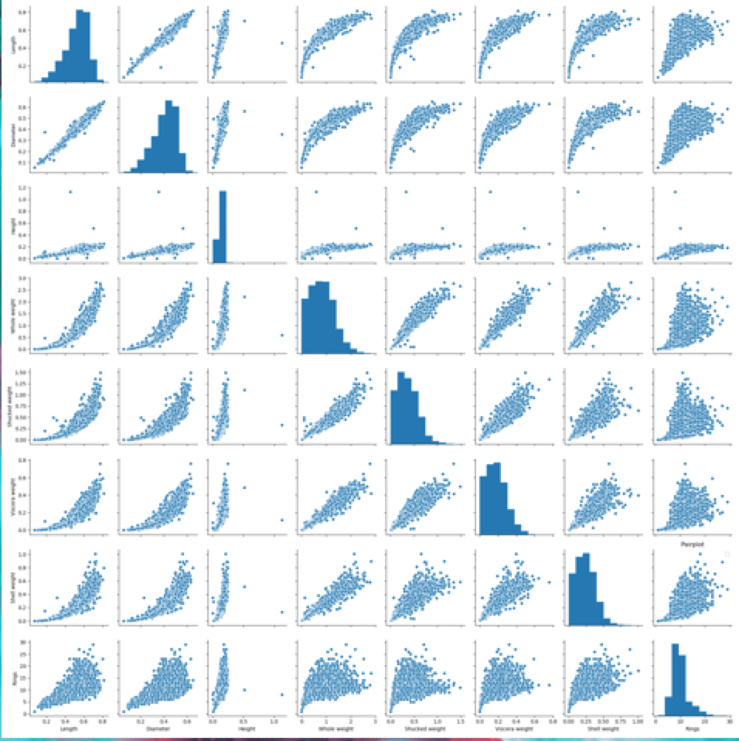
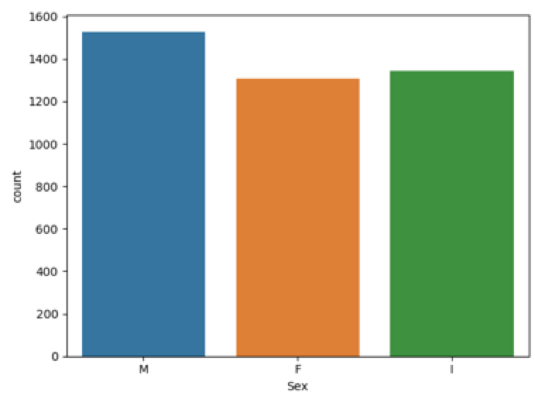
Pair plot
Count plot

Slide 12
Preprocessing

Slide 13
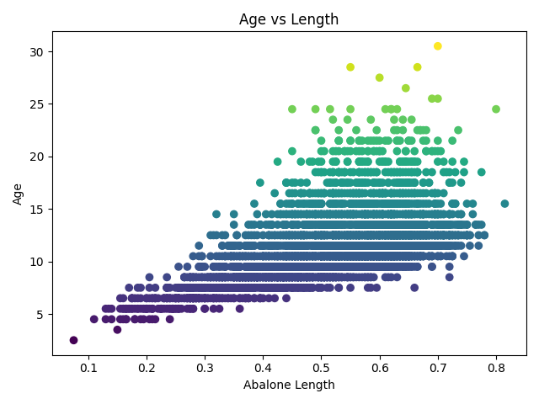
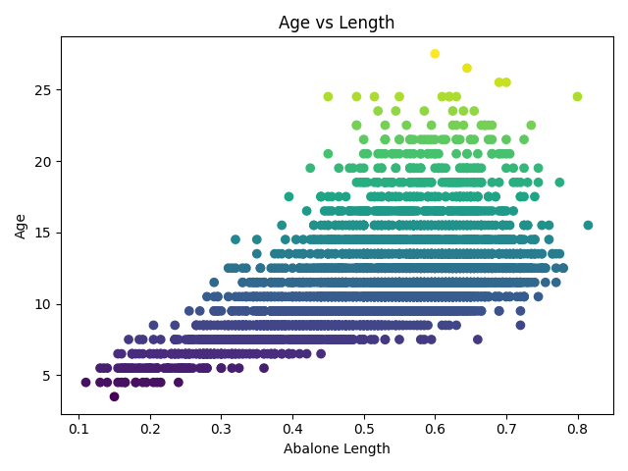
Age vs Length

Slide 14
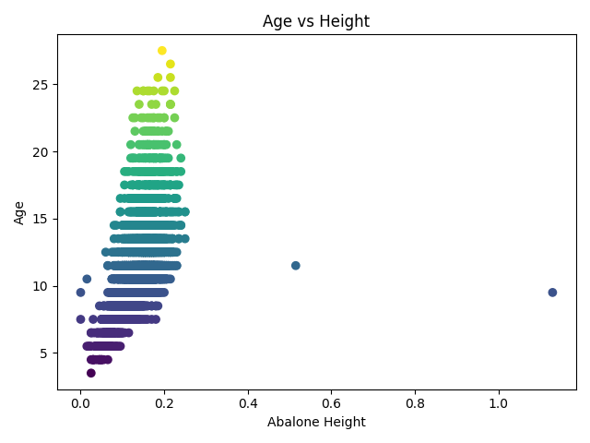
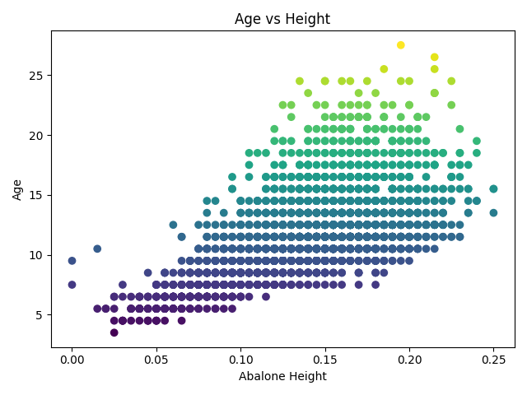
Age vs Height

Slide 15
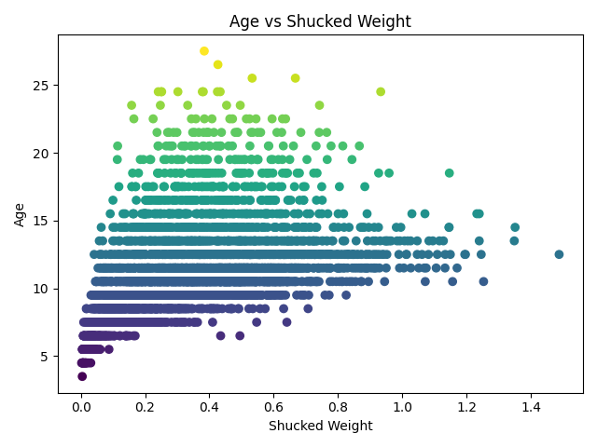
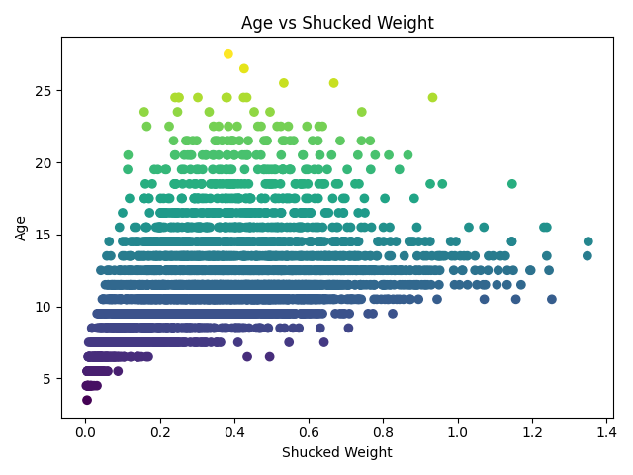
Age vs Shucked Weight

Slide 16
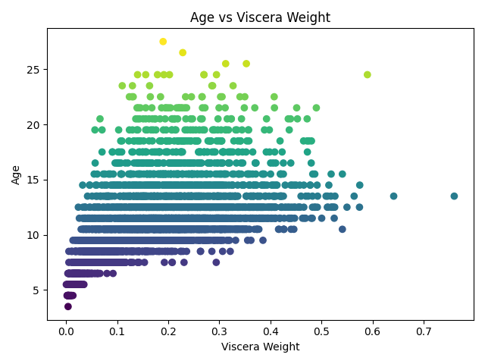
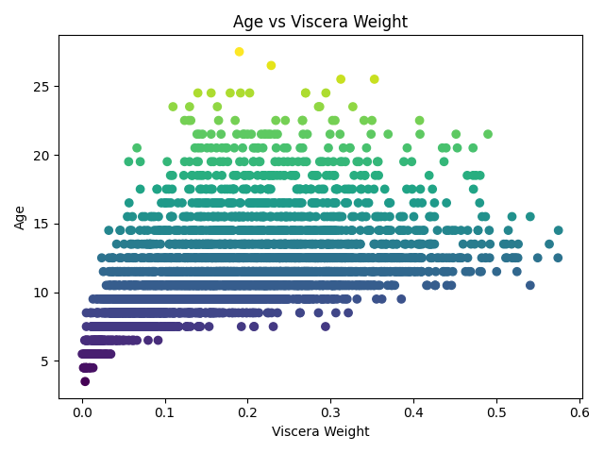
Age vs Viscera Weight

Slide 17
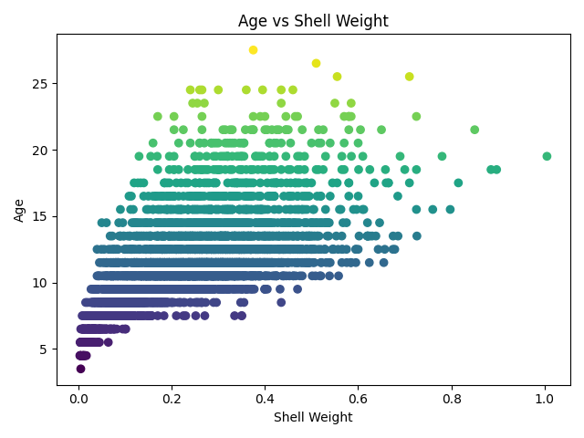
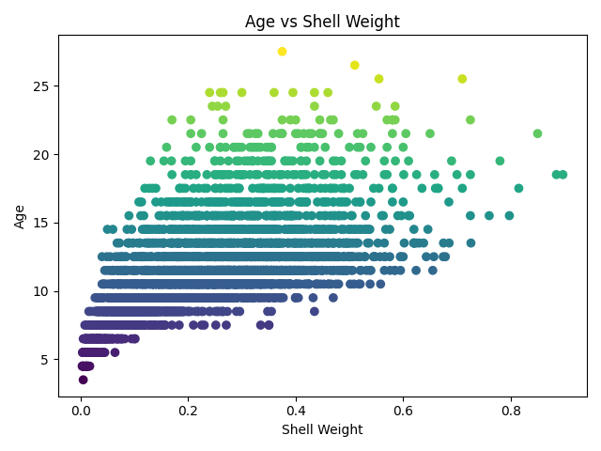
Age vs Shell Weight

Slide 18
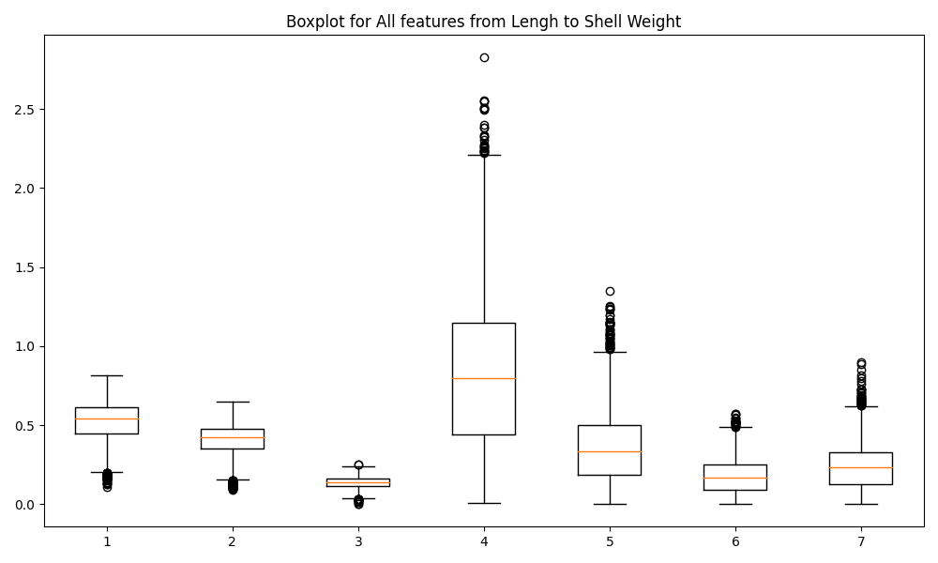
A boxplot gives a good indication of how the values in the data are spread out
Check Each Feature: Boxplot

Slide 19
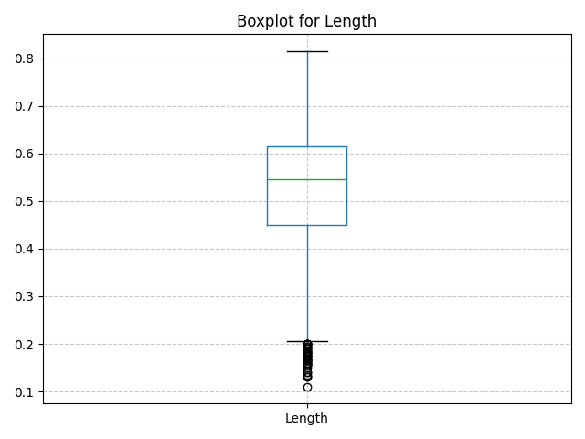
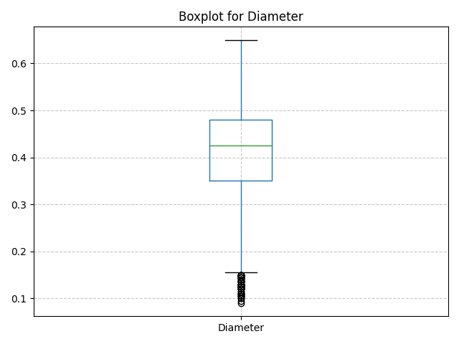
Boxplot: Length & Diameter

Slide 20
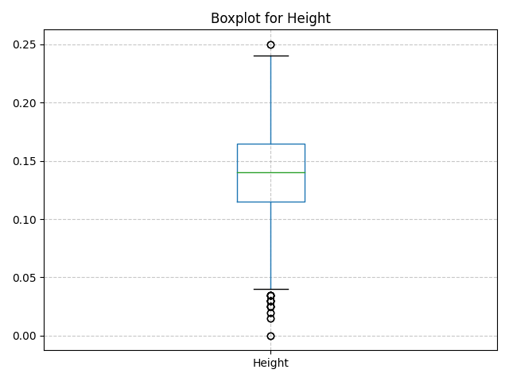
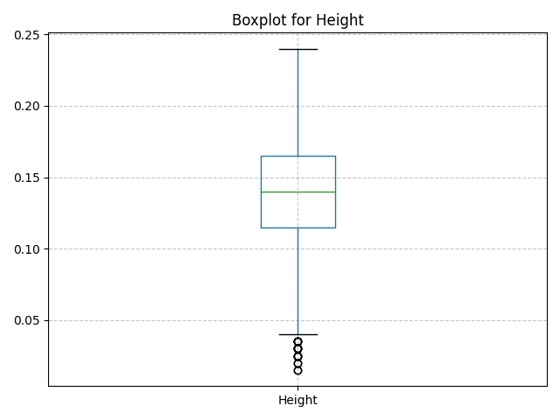
Boxplot: Height

Slide 21
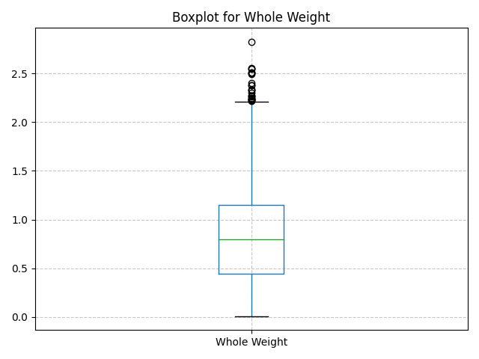
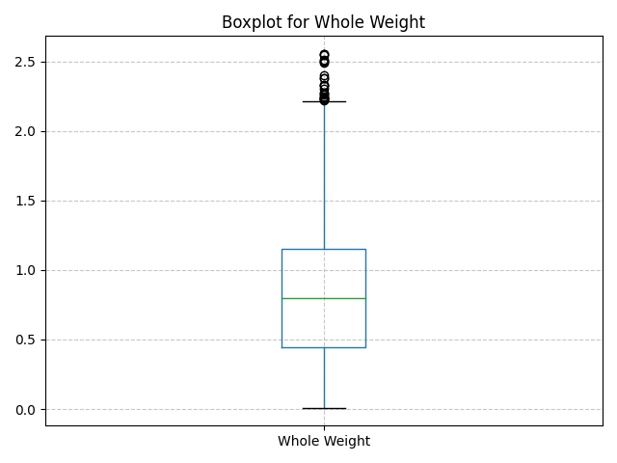
Boxplot: Whole Weight

Slide 22
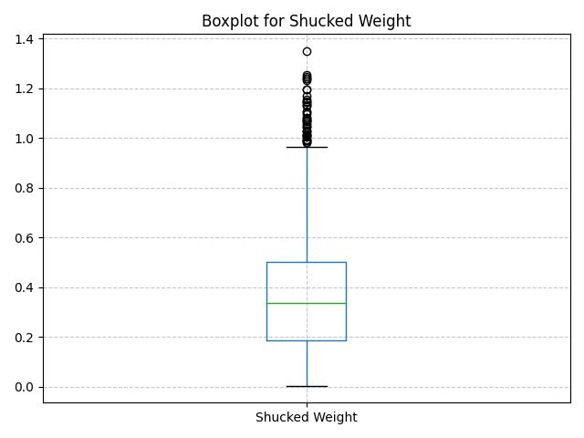
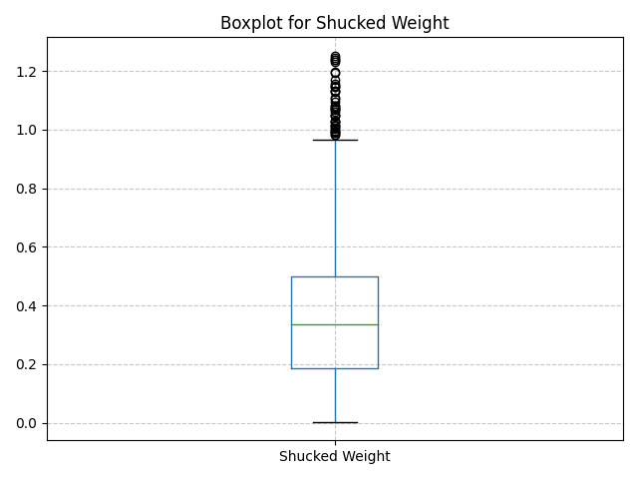
Boxplot: Shucked Weight

Slide 23
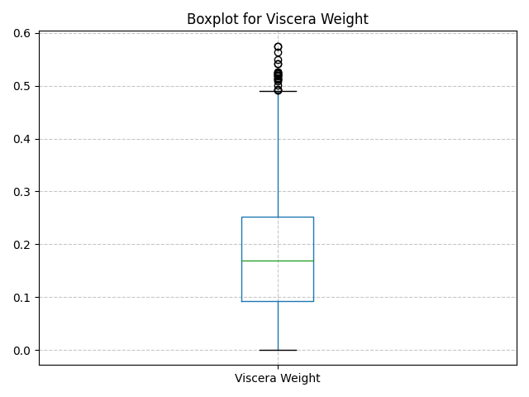
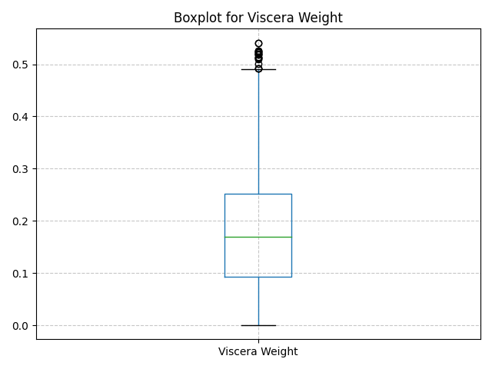
Boxplot: Viscera Weight

Slide 24
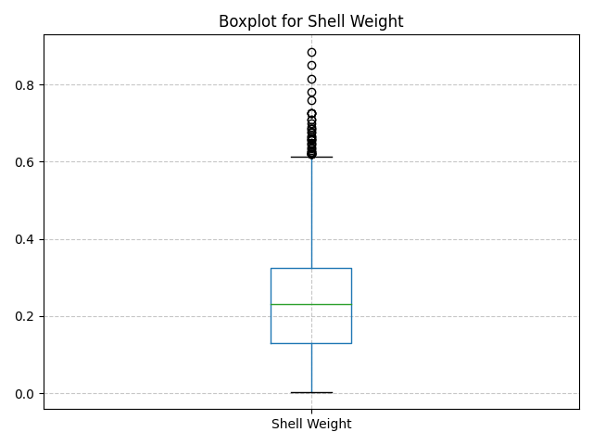
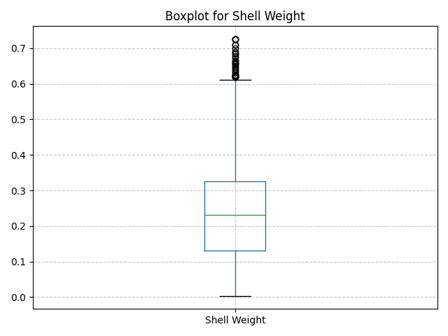
Boxplot: Shell Weight

Slide 25
PCA (Principle Component Analysis)

Slide 26
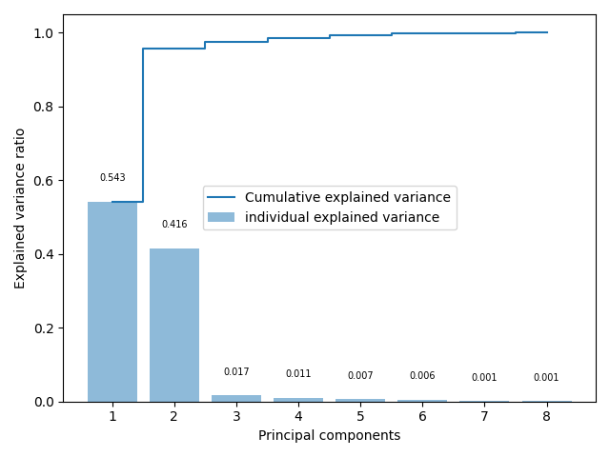
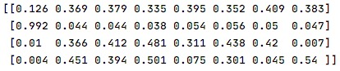
explained variance
PCA.COMPONENTS

Slide 27
Linear Regression

Slide 28
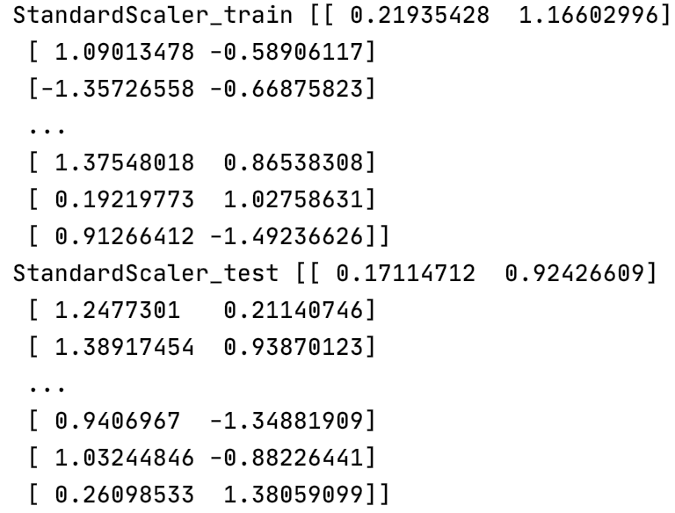
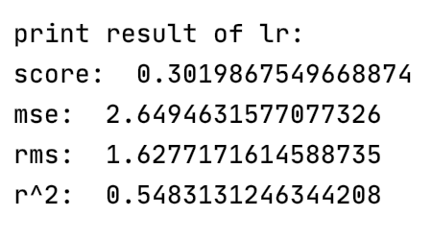
Standardization
Result

Slide 29
Plot of linear regression

Slide 30
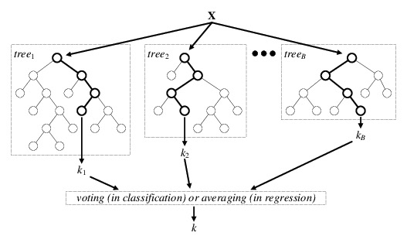
Random Forest
Random forests is an ensemble learning Method for classification , regression and other tasks that operate by constructing a multitude of decision trees.

Slide 31
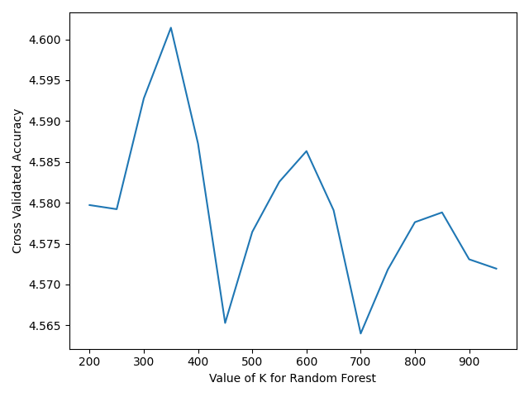
Model Training & Parameter Optimization
200 – 900 Number of Trees

Slide 32
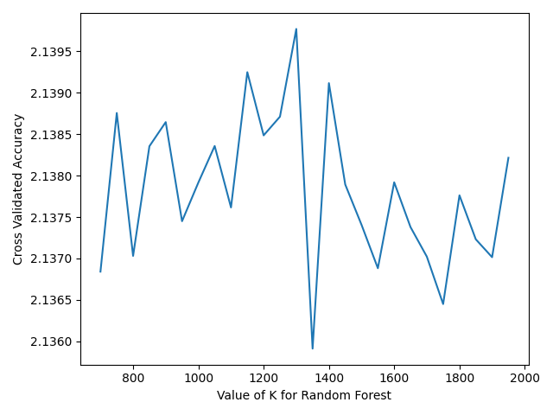
Model Training & Parameter Optimization
500– 2000 Number of Trees with step size 50

Slide 33
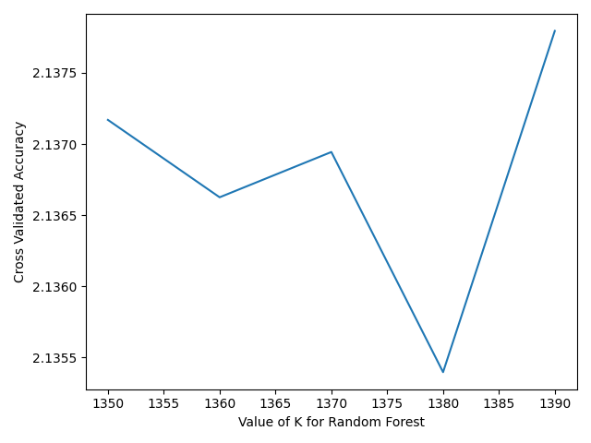
Model Training & Parameter Optimization
1300– 1400 Number of Trees with step size 10

Slide 34
Model Training & Parameter Optimization
Number of Trees in Forest: 1380
RMSE: 2.1029581
R2 : 0.5353836

Slide 35
Neuron Network

Slide 36
Plot of training set and prediction

Slide 37
Confusion matrix of NN
Cv: 0.233-0.278

Slide 38
Confusion matrix of NN
Cv: 0.70

Slide 39
Logistic Regression

Slide 40
Confusion matrix of Logistic Regression
Cv:0.263

Slide 41
Confusion matrix of Logistic Regression
Cv:0.68

Slide 42
Results

Slide 43
Comparison between models
Regression algorithms
Model | RMSE | R-Squared
Linear regression | 1.628 | 0.548
Random Forest | 2.104 | 0.535
The better one
Classification algorithms
Model | RMSE | R-Squared | Accuracy score
Multiple layer perceptron | 0.55 | -0.39 | 0.70
Logistic regression | 0.46 | -0.004 | 0.72
In our report, we compare our classification modes with more indexes in classification report.
The better one
The model still needs to be improved.

Slide 44
Summary & Conclusion

Slide 45
Summary & Conclusion
Regression algorithm
Classification algorithm
Observing confusion matrix and accuracy score would decide the effect of the model.
The higher accuracy score, the better the model.
The lower RMSE and higher R-squared, the better the model.
Linear regression is better
Logistic regression is better

Slide 46
Limitation & Proposed Solution

Slide 47
The performance of our model is not as good as what we have expected, probably due to the imbalanced data set.
The solution to this problem is reducing the number of class into binary class. The model can predict general range of age of abalone.
Other solutions involve increasing more instance and features by provide some feature engineering.

Slide 48
Thank You

